Slide 1
Software Architecture and Design I SOEN 343 Instructor: Dr. Rodrigo Morales https://moar82.github.io/ rodrigo.moralesalvarado@concordia.ca
Lecture 12: DISTRIBUTED ARCHITECTURE part 1
Ch 10. Textbook:
Software architecture and design illuminated / Kai Qian ... [et al.]
Publisher Sudbury, Mass. : Jones and Bartlett Pub., c2010.
Notes:
1

Slide 2
Objectives
Introduce the client-server and multi-tier architectures
Web server, server-side programming, and DB server examples
Introduce the service-oriented architecture
Present SOAP as an example of SOA

Slide 3
Introduction
A distributed system is a collection of computational and storage devices connected through a communications network
In this kind of systems data, software, and users are distributed
The sub-systems or components within a distributed system communicate with each other using several methods including message passing, remote procedure call, remote method invocation, etc.

Slide 4
Two important issues for designing a distributed system are:
Network Topology: the way in which entities are organized to form a connected network
Communications Mode: the method by which components communicate with each other

Slide 5
A distributed system can be modeled by the client-server architecture, and this forms the basis for multi-tier architectures; alternatives are the broker architecture such as CORBA, and the Service-Oriented Architecture (SOA) such as Web services and Grid services
The important features of a distributed architecture are its service location transparency, and its services reliability and availability

Slide 6
Additionally, there are several technology frameworks to support distributed architectures, including .NET, J2EE, CORBA, .NET Web services, AXIS Java Web services, and GloBus Grid services

Slide 7
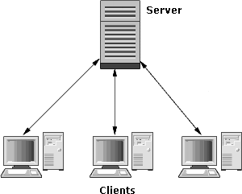
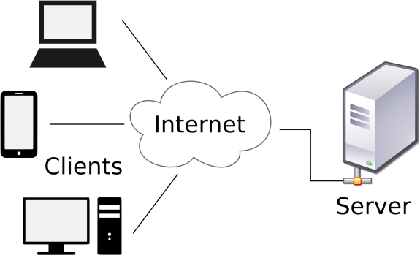
Client-server architecture
Components and connectors
In the client–server architectural style, components are servers (providers of a resource), and clients (service requesters)
Connectors are the protocols through which clients and servers use to communicate

Slide 8
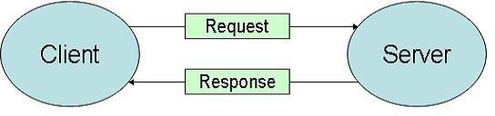
Components and connectors
A server host runs one or more server programs which share their resources with clients. The sharing of resources of a server constitutes a service
A client does not share any of its resources, but requests a service from a server
A client initiates a communication session by sending a request to one or more connected servers
A server accepts a request, processes it, and returns the requested information to the client(s)

Slide 9
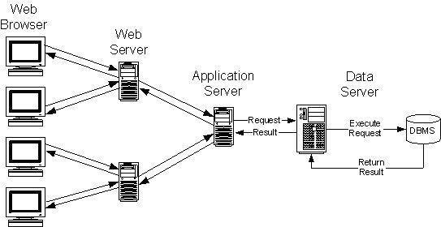
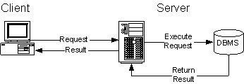
Client-server architecture
Components and connectors
A server can itself act as a client to another server

Slide 10
Client-server architecture: topology
The topology is normally a many-to-one (many clients to one server) but can also be one-to-one
Because the server can perform a limited number of tasks at any moment, it relies on a scheduling system to prioritize incoming requests from clients in order to accommodate them all in turn

Slide 11
Example: Web servers
A web server is a computer system that stores, processes and delivers web pages to clients upon requests via HTTP, protocol
The most common use of web servers is to host websites, but there are other uses such as gaming, data storage, running enterprise applications, handling email, FTP, etc.
A client, commonly a web browser initiates communication by making a request for a specific resource using HTTP and the server responds with the content of that resource or an error message if unable to do so
Notes:
A web server is a computer system that stores, processes and delivers web pages to clients upon requests via HTTP, the basic network protocol used to distribute information on the World Wide Web
The term can refer either to the entire system, or specifically to the software that accepts and supervises the HTTP requests
The most common use of web servers is to host websites, but there are other uses such as gaming, data storage, running enterprise applications, handling email, FTP, or other web uses
A client, commonly a web browser or web crawler, initiates communication by making a request for a specific resource using HTTP and the server responds with the content of that resource or an error message if unable to do so

Slide 12
Server-side programming
It is a technique used in web development which involves employing scripts on a web server which produce a response customized for each client's request to a website
This function is used to generate HTML documents on-the-fly
The alternative is for the web server itself to deliver a static web page
Scripts can be written in any of several server-side scripting languages that are available
Notes:
Server-side scripting is a technique used in web development which involves employing scripts on a web server which produce a response customized for each user's (client's) request to the website
This means that the behaviour of the web server can be scripted in separate files, while the actual server software remains unchanged
Usually, this function is used to generate HTML documents dynamically ("on-the-fly").
The alternative is for the web server itself to deliver a static web page
Scripts can be written in any of a number of server-side scripting languages that are available

Slide 13
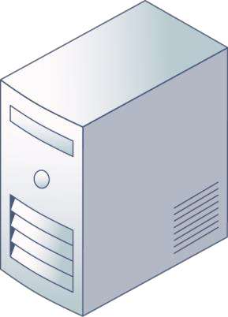
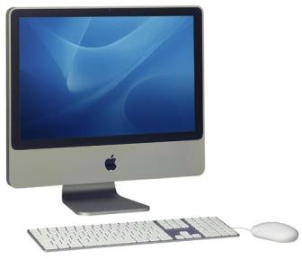
Example: Server-side programming
Web browser sends a request to the web server.
The web server Executes embedded Scripts;
It produces a formatted document and sends the result to the browser.
The web browser displays
the document.

Slide 14
Server-side technologies
ASP.NET
C via CGI
Groovy Server Pages
Java (*.jsp) via JavaServer Pages
JavaScript using Server-side JavaScript
Lua
Perl CGI
PHP
R
Python
Ruby

Slide 15
Client-side programming and technologies
Client side code is executed and stored on a client (web browser)
A client-side script is often embedded within an HTML or XHTML document. It can also be contained in a separate file, which the document(s) that use it make reference to (known as an "external script").
Technologies include:
Ajax (Asynchronous JavaScript + XML)
JavaScript, jQuery (JavaScript library)
AngularJS
HTML5 and CSS3
Notes:
Client side code is executed and stored on a client (web browser).
A client-side script is often embedded within an HTML or XHTML document. It can also be contained in a separate file, which the document(s) that use it make reference to (known as an "external script").
Technologies include:
Ajax (Asynchronous JavaScript + XML)
JavaScript, jQuery (JavaScript library)
AngularJS
HTML5 and CSS3

Slide 16
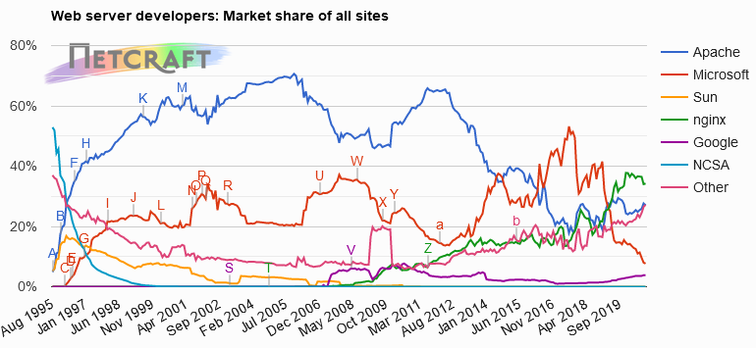
2019 Web Server survey
Source: Netcraft
Retrievable from http://news.netcraft.com/archives/category/web-server-survey/
66

Slide 17
Example: Database servers
A database server is a computer program that provides database services to clients
The term may also refer to a computer dedicated to running such a program
Database management systems (DBMSs) frequently provide database server functionality
67

Slide 18
Example: Web database transaction
Client sends
request
to web server.
Web server decodes and validates request. Forwards request to application server.
Application server executes business logic.
Sends request to database server.
Database server
executes the request (e.g. SQL) and sends result back to application server.
3
4
1
6
2
5
Web server responds
to client.
Application server may
execute additional logic.
Sends response to web server.

Slide 19
Variations of client-server architecture
In designing a client–server application, a decision is to be made as to which parts of the task should be executed on the client, and which on the server
This decision would affect the cost of clients and servers, the robustness and security of the application as a whole, and the maintainability of the design (modification or porting)

Slide 20
Variations of client-server architecture
There can be many versions of this:
All business services in the client.
Part of business services in the client.
Only GUI in client.
Thin client: The bulk of the data processing occurs on the server.
Fat (or thick) client: Bulk of processing done on client. No need for continuous server communications. When disconnected from the network, it is often referred to as a workstation.

Slide 21

Client server: Design issues
Authentication: Verifying the identity of the client and the server
Authorization: Verifying the rights/privileges of the client
Data security: Protect the data stored on the server
Protection: Protect the server from malfunctioning clients
Middleware: How to connect the clients to the server

Slide 22
Advantages:
Separation of responsibilities such as user interface presentation and business logic processing.
Reusability of server components.
Disadvantages:
Lack of heterogeneous infrastructure to deal with the requirement changes.
Security complications.
Server availability and reliability.
Testability and scalability.
Fat clients with presentation and business logic together.

Slide 23
Multitier architectural style

Slide 24
Multitier (or N-tier) architectures
This is a variation of a client-server architecture applied to a system that contains clients, processing, and persistent data storage.
In multitier systems, the presentation, application processing and data management (persistent data storage) functions are physically separated

Slide 25
Tiers vs. layers
The terms “tier” and “layer” are often used interchangeably.
A layer is a logical structuring mechanism for the elements that make up a software solution
A tier is a physical mechanism for the system’s infrastructure
A tier corresponds to a computing platform and includes a hardware architecture and a software framework that allows the software to run
A tier is a place where one or more layers are deployed and run

Slide 26
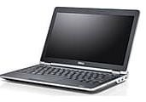
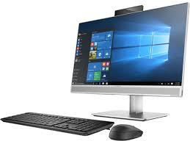
2-Tier client-server architecture
Presentation tier
Data tier
Web server
Database server

Slide 27
3-tier client-server architecture
Presentation tier
Application tier
Data tier
Web server
Application server
Database server
The most widespread use of the multi-tier architectural style

Slide 28
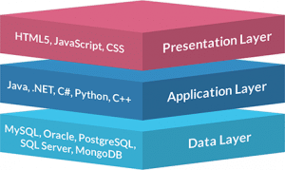


3-tier client-server architecture /cont.
UI
not the Java
Swing libraries, but our GUI classes based on Swing
Swing
Web
Domain
Sales Payments
Taxes
Technical Services
Persistence
Logging
RulesEngine
Presentation tier: User interface. Clients never directly communicate with data tier
Application tier: Controls an application’s functionality and acts as a middleware layer
Data tier. Database management system
•

Slide 29
3-tier client-server architecture /cont.
Presentation tier
The presentation tier consists of the user interface
The user interface is accessible through a web browser (or web-based application)
The tier is often built on HTML, CSS, JavaScript

Slide 30
3-tier client-server architecture /cont.
Application tier
The application tier contains the business logic (the core functionality of the application).
Often implemented in Java, .NET, C#, Python, etc.

Slide 31
3-tier client-server architecture /cont.
Data tier
The Data tier contains the database management system
Often implemented in MySQL, Oracle, etc.

Slide 32
Advantages of 3-tier architectures
Specific layers can be upgraded with minimal impact on the other layers
Helps improve development efficiency (focusing on front- end, server back-end, and data back-end development)
Can scale each tier independently depending on the need at any given time (i.e. can load balance each layer independently)
Modularization of tiers provides several deployment options (a tier may be hosted on private/public cloud on on-site)
105

Slide 33
2-Tier vs. 3-tier architectures
2-Tier
Faster communication (due to high coupling between presentation- and data tier)
Performance issues (not scalable, because each client requires its own database session)
3-Tier
Scalability and performance
Good maintainability (and reuse)
Good database security
May be highly complex

Slide 34
Service oriented architectures

Slide 35
Service-Oriented Architecture (SOA)
A Service Oriented Architecture (SOA) starts with a businesses process
In this context, a service is a business functionality that is well-defined, self-contained, independent from other services, and published and available to be used via a standard programming interface
Software manages business processes through a SOA with well-defined and standard interfaces that can build, enhance, and expand their existing infrastructure more flexible

Slide 36
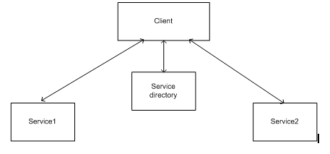
Client with services and service directory
Notes:
The figure above illustrates how SOA works. A client can find a service-x via a service directory and then accesses service-x in a service request-response mode

Slide 37
SOAP: simple-object-access-protocol
Huge number of applications are built on different programming languages
Exchanging data between applications is crucial in today’s network world
One method to combat this complexity is to use XML as intermediate language
But there are not standard specification protocol
Notes:
In today's world, there is huge number of applications which are built on different programming languages. For example, there could be a web application designed in Java, another in .Net and another in PHP.
Exchanging data between applications is crucial in today's networked world. But data exchange between these heterogeneous applications would be complex. So will be the complexity of the code to accomplish this data exchange.
One of the methods used to combat this complexity is to use XML (Extensible Markup Language) as the intermediate language for exchanging data between applications.
Every programming language can understand the XML markup language. Hence, XML was used as the underlying medium for data exchange.
But there are no standard specifications on use of XML across all programming languages for data exchange. That is where SOAP comes in.

Slide 38
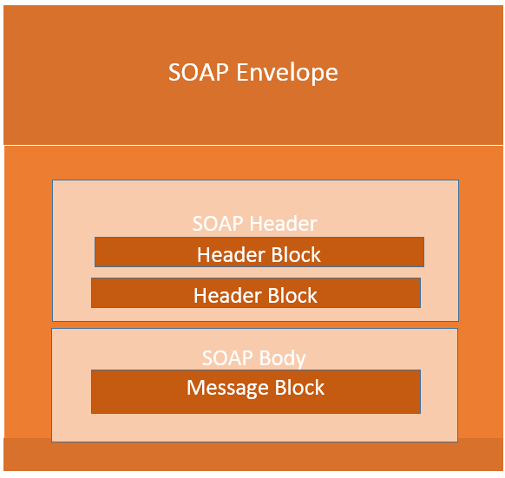
SOAP building blocks
Notes:
The SOAP specification defines something known as a "SOAP message" which is what is sent to the web service and the client application.
The SOAP message is nothing but a mere XML document which has the below components.
An Envelope element that identifies the XML document as a SOAP message – This is the containing part of the SOAP message and is used to encapsulate all the details in the SOAP message. This is the root element in the SOAP message.
A Header element that contains header information – The header element can contain information such as authentication credentials which can be used by the calling application. It can also contain the definition of complex types which could be used in the SOAP message. By default, the SOAP message can contain parameters which could be of simple types such as strings and numbers, but can also be a complex object type.

Slide 39
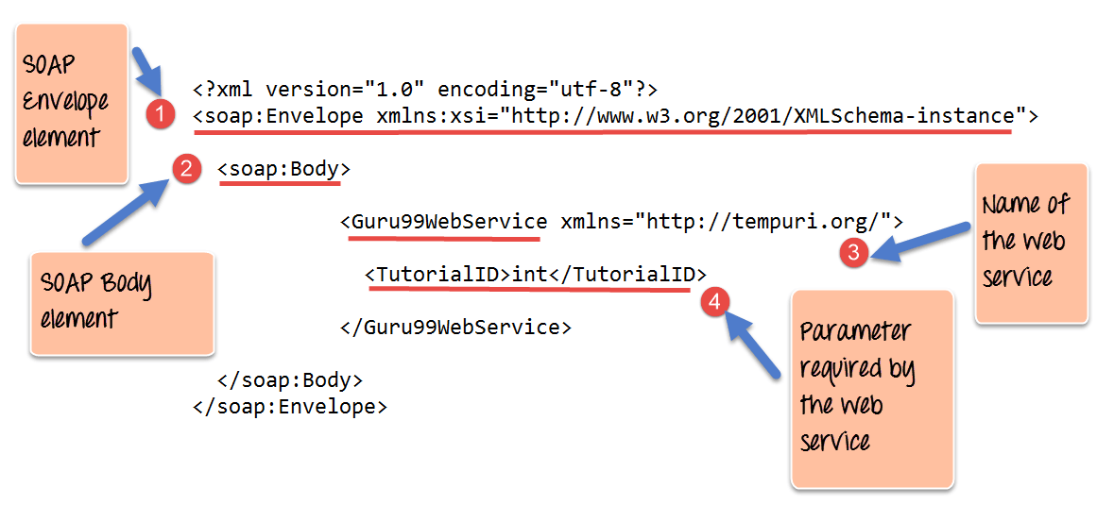
SOAP message structure
Notes:
One thing to note is that SOAP messages are normally auto-generated by the web service when it is called.
Whenever a client application calls a method in the web service, the web service will automatically generate a SOAP message which will have the necessary details of the data which will be sent from the web service to the client application.
As discussed in the previous topic, a simple SOAP Message has the following elements –
The Envelope element
The header element and
The body element
The Fault element (Optional)

Slide 40
SOAP communication Model vs RPC
All communication by SOAP is done via HTTP protocol
Prior to SOAP, a lot of web services used RPC which have the following limitations:
Not language independent
Not the standard protocol
Problems with firewalls
Notes:
All communication by SOAP is done via the HTTP protocol. Prior to SOAP, a lot of web services used the standard RPC (Remote Procedure Call) style for communication. This was the simplest type of communication, but it had a lot of limitations.
Let's consider the below diagram to see how this communication works. In this example, let's assume the server hosts a web service which provided 2 methods as
GetEmployee - This would get all Employee details
SetEmployee – This would set the value of the details like employees dept, salary, etc. accordingly.
In the normal RPC style communication, the client would just call the methods in its request and send the required parameters to the server, and the server would then send the desired response.

Slide 41
SOAP communication Model vs RPC
The client would format the information regarding the procedure call and any arguments into a SOAP message and sends it to the server as part of an HTTP request
This process of encapsulating the data into a SOAP message was known as Marshalling
The server would then unwrap the message sent by the client, see what the client requested for and then send the appropriate response back to the client as a SOAP message
The practice of unwrapping a request sent by the client is known as Demarshalling.
Notes:
To overcome all the limitations cited above, SOAP would then use the below communication model
The client would format the information regarding the procedure call and any arguments into a SOAP message and sends it to the server as part of an HTTP request. This process of encapsulating the data into a SOAP message was known as Marshalling.
The server would then unwrap the message sent by the client, see what the client requested for and then send the appropriate response back to the client as a SOAP message. The practice of unwrapping a request sent by the client is known as Demarshalling.

Slide 42
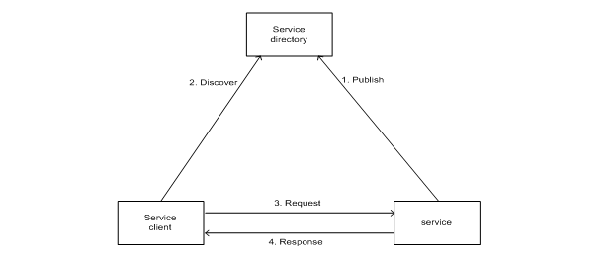
SOA implementation in web services
Notes:
A web service is a service that communicates with other services or clients via standard protocols and technologies such as SOAP, XML, and HTTP. A web service is set to be message-oriented service that can deliver document-oriented messages as well as RPC messages. Because an XML based message is semi-structured, it makes a web service architecture universally accessible and flexible

Slide 43
Summary
Multi-tier architecture distributes and separates data and processing duties over different tiers so that each tier has its own responsibilities
The client-server architecture is widely used in current enterprise business and industry. Web server, data server, and application server are all examples of server tiers
Service-oriented architectures are widely used in B2B enterprise business applications. Each service is a building-block component, such as web or grid service, which can be reused by other service components or other business process applications
Notes:
In this lecture we discussed the software architectures for distributed computing systems, those systems where data, users, and processing elements are all distributed over remote sites connected by networks.
Multi-tier architecture distributes and separates data and processing duties over different tiers so that each tier has its own
responsibilities. It reduces message traffic on the network and increases system reliability.
The client-server architecture is widely used in current enterprise business and industry. Web server, data server, and application
server are all examples of server tiers.
Service-oriented architectures are widely used in B2B enterprise business applications. Each service is a building-block component,
such as web or grid service, which can be reused by other service components or other business process applications.

Slide 44
References
Ch 10. Textbook: Software architecture and design illuminated / Kai Qian [et al.]. Jones and Bartlett Pub., 2010.
SOAP https://www.guru99.com/soap-simple-object-access-protocol.html

